Slide 1
2022 CPUC Draft Avoided Cost Calculator Workshop
June 30, 2022

Slide 2
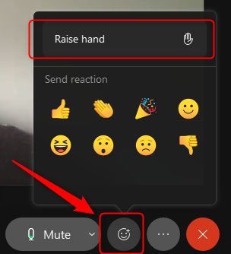
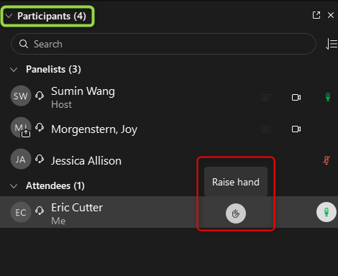
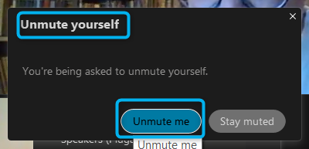
General Information
Please use the Q&A function to ask questions. (That leaves the chat free for general announcements.)
Please use the “raise hand” function if you want ask a question verbally and we will unmute you.
This workshop will be recorded and the recording and the slides will be made available.
Q&A Panel
Lower-Right
Raise Hand
Lower-Middle
Participants Panel
Upper-Right
Unmute
A host will unmute you – then you must click button to unmute yourself

Slide 3
2022 CPUC Draft Avoided Cost Calculator Workshop
06/30/2022

Slide 4
Agenda
Topic | Presenter | Approximate Time
Introduction | Energy Division | 9:00—9:05 am
Comparison of 2022 and 2021 ACC | E3 | 9:05—9:15 am
Discussion of No New DER scenario and overview of SERVM data + discussion | Energy Division / E3 | 9:15—9:55 am
New method for annualization for generation capacity | E3 | 9:55—10:05 am
California Large Energy Consumers Association (CLECA) Presentation | CLECA | 10:05—10:15 am
Discussion of GC annualization method & CLECA Presentation | E3 / CLECA / Stakeholders | 10:15—10:25 am
Using SERVM instead of RECAP for allocation of generation capacity value + discussion | Energy Division / E3 | 10:25—10:40 am
Transmission and Distribution, including secondary distribution + discussion | E3 | 10:40—11:10 am
Break |  | 11:10—11:20 am
Changes to natural gas values, now using IEPR + discussion | E3 | 11:20—11:30 am
Interim natural gas GHG adder + discussion | E3 | 11:30—11:50 am
Avoided Gas Infrastructure Cost (AGIC) + discussion | Energy Division / E3 | 11:50—12:00 pm
Refrigerant Calculator + discussion | E3 | 12:00—12:10 pm
Solar Energy Industry Association (SEIA) presentation + discussion | SEIA | 12:10—12:30 pm

Slide 5
Comparison of Results with 2021 ACC

Slide 6
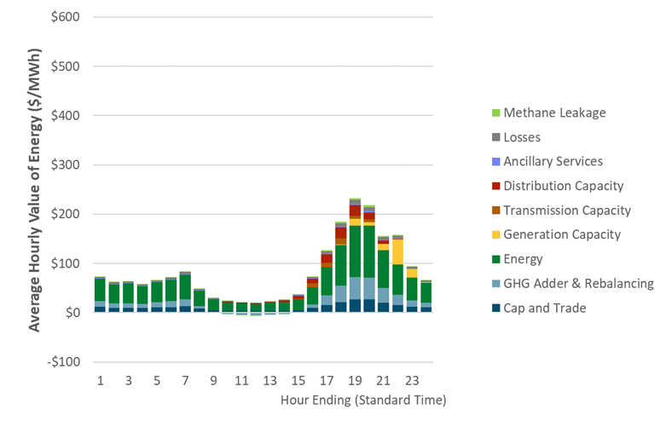
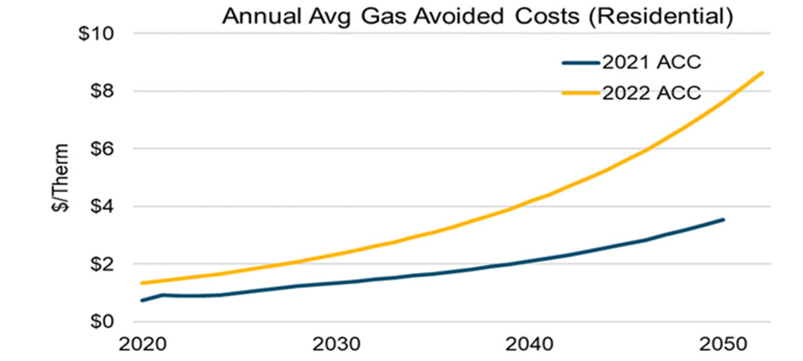
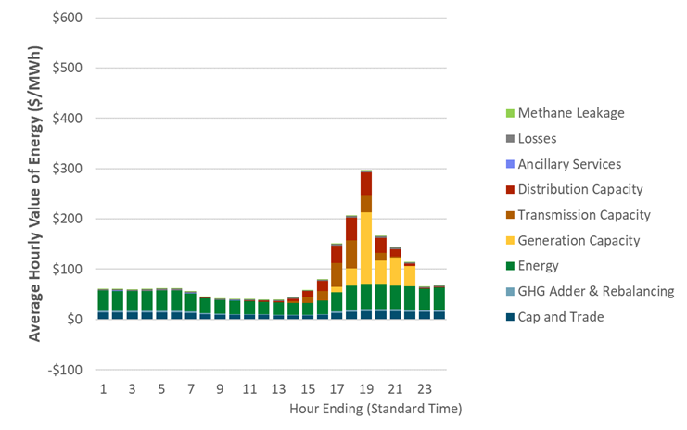
2022 Draft Avoided Cost Calculator (ACC) sees higher avoided costs across several categories in near and mid term
2021 ACC
Electric Avoided Costs
Higher generation capacity avoided costs based on net costs of storage
Higher short-term distribution capacity avoided costs for PG&E
Higher transmission capacity avoided costs for PG&E
Higher energy prices during the middle of the day from SERVM around 2030
Lower greenhouse gas (GHG) value from RESOLVE
Natural Gas Avoided Costs
Natural gas avoided costs double as 2022 ACC adopts separate GHG value for the natural gas sector to reflect the higher costs to decarbonize gas
2030 PG&E CZ12
2022 ACC
2030 PG&E CZ12

Slide 7
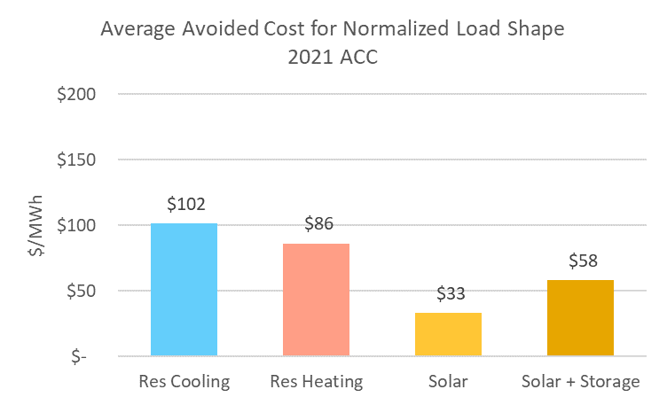
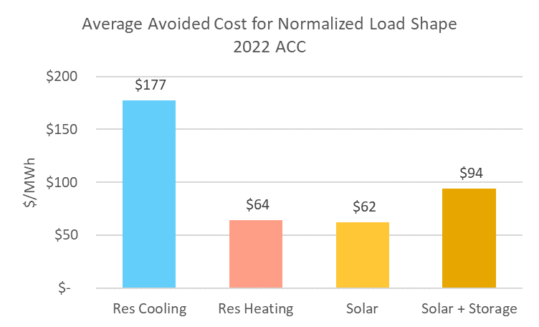
Energy Efficiency & Solar – 2030 PG&E CZ12
Energy efficiency or solar will see an increase in avoided costs if they can capture high-capacity hours in summer and high midday energy prices
2021 ACC
2022 ACC

Slide 8
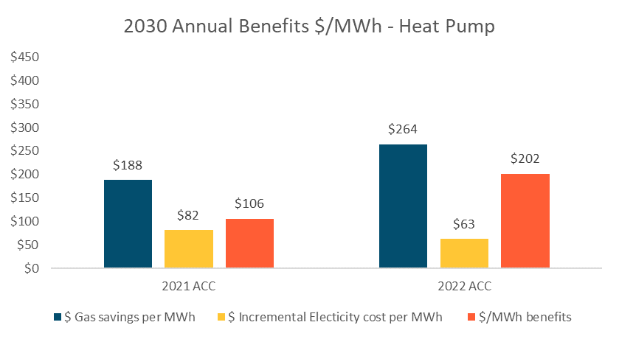
Electrification – 2030 PG&E CZ12*
Electrification measures (e.g., heat pump for space heating) that avoid natural gas consumption will see an improvement in cost effectiveness
Increased natural gas avoided costs due to higher natural gas GHG value
Decreased incurred electricity costs due to winter consumption
*This slide has been revised after the workshop to address a small mistake in pulling the wrong data from ACC.

Slide 9
No New DER Scenario

Slide 10
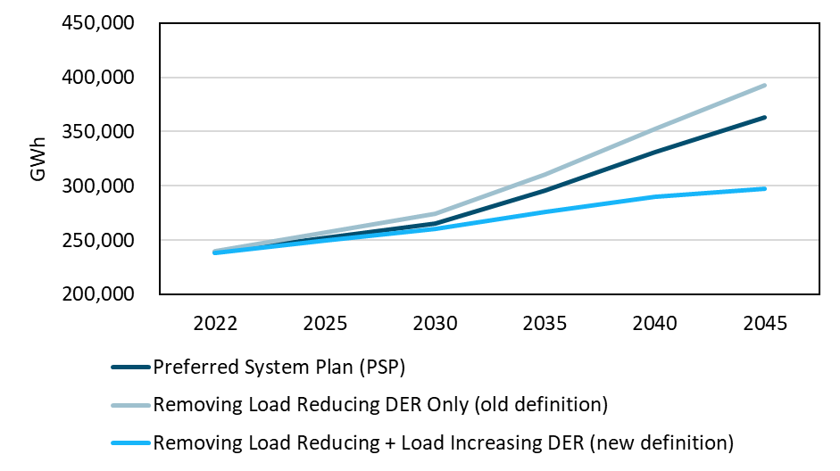
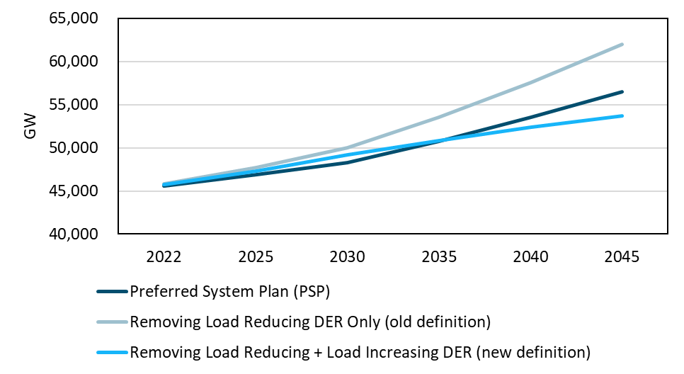
Removing All DER Results in Lower Annual and Peak Load
2022 ACC removes all incremental load reducing (e.g., solar, storage, EE) and load increasing (e.g., building and transportation electrification) DER in the “No New DER” scenario
It generally results in lower annual and peak load compared to the Preferred System Plan (PSP)
It also results in low GHG value because of two major reasons:
With the same emission cap, lower annual load makes it easier for system to meet the emission target
“No New DER” scenario results in higher peak load in 2030. The system builds batteries for capacity needs, and they help meet the GHG target by reducing the curtailments of renewables, putting downward pressure on GHG value
Annual Load (GWh)
Peak Load (GW)
The impact of removing energy efficiency outweighs the impact of removing electrification on peak load
*Annual load does not reflect the impact of removing BTM PV and storage (modeled as supply side resource in RESOLVE)

Slide 11
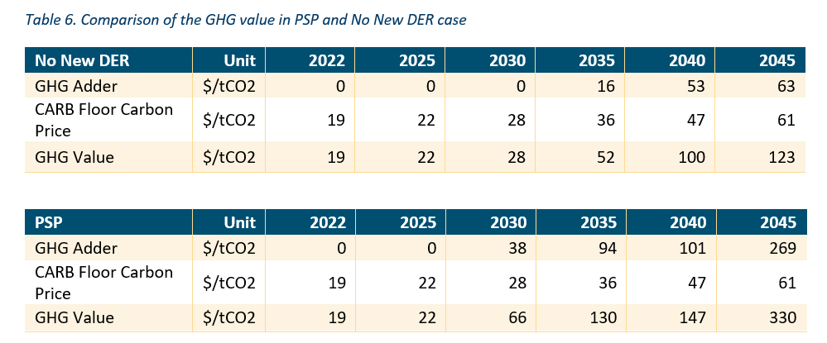
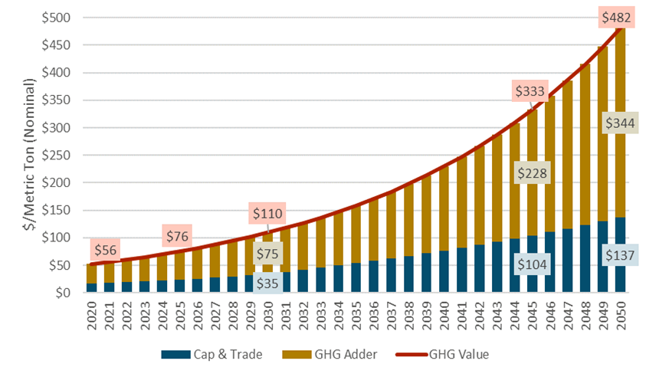
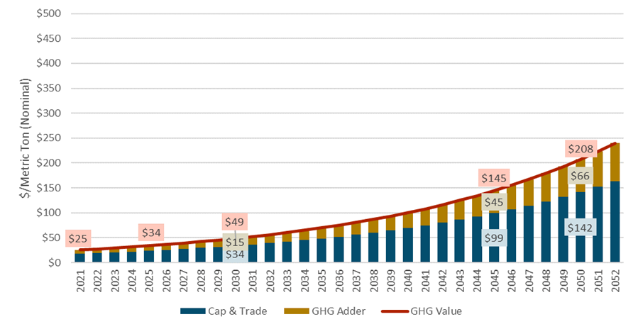
2022 ACC GHG Value Drops Compared to 2021 ACC
RESOLVE total GHG value stays at the cap-and-trade value and shows zero GHG adder in 2030
2022 ACC GHG value is extrapolated from the GHG value in 2035 from RESOLVE using utility WACC
GHG value drops by a half compared to 2021 ACC
GHG Value Extrapolated in 2021 ACC
GHG Value Extrapolated in 2022 ACC

Slide 12
Comparison of Selected Resource Capacity
Near term additions in PSP include the procurement order. The “No New DER” scenario builds more storage for capacity needs
In the long term, the “No New DER” scenario builds less resources due to lower load, but still with significant amount of solar penetration
Includes 11.5GW procurement order between 2023-2026

Slide 13
SERVM Prices

Slide 14
SERVM Scarcity Adjusted Energy Prices
SERVM is used to forecast energy and ancillary services prices for ACC because IRP has validated resource portfolios in SERVM
2022 ACC makes an improvement to have price forecasts to 2045 to capture long term price dynamics
Near term energy price patterns are consistent with the 2021 historical prices with low prices during spring month and high prices in summer evenings
Lower energy prices in the middle of the day with increased solar penetration

Slide 15
SERVM Ancillary Service Prices - Reg
SERVM AS prices need further evaluation
Near term SERVM AS prices are low compared to historical prices during the summer peak hours
Long term SERVM AS prices remain flat

Slide 16
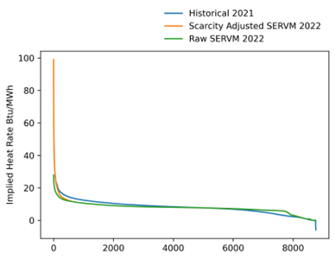
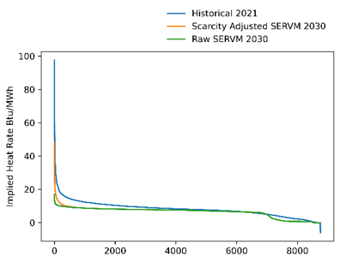
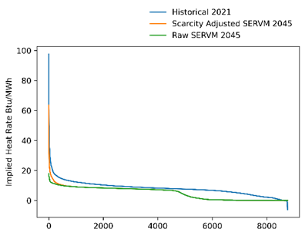
SERVM Implied Heat Rates
Acknowledging the discrepancy between the natural gas price forecasts used in SERVM (comes from 2020 IEPR) and market prices, implied heat rate is used for benchmarking
Near term SERVM prices are close to historical 2021 implied heat rate
Scarcity adjustment limited to 5% to ensure the equation best captures the dynamics during the highest-demand hours
In the long term, more zero price hours due to renewable penetration
2022
2030
2045

Slide 17
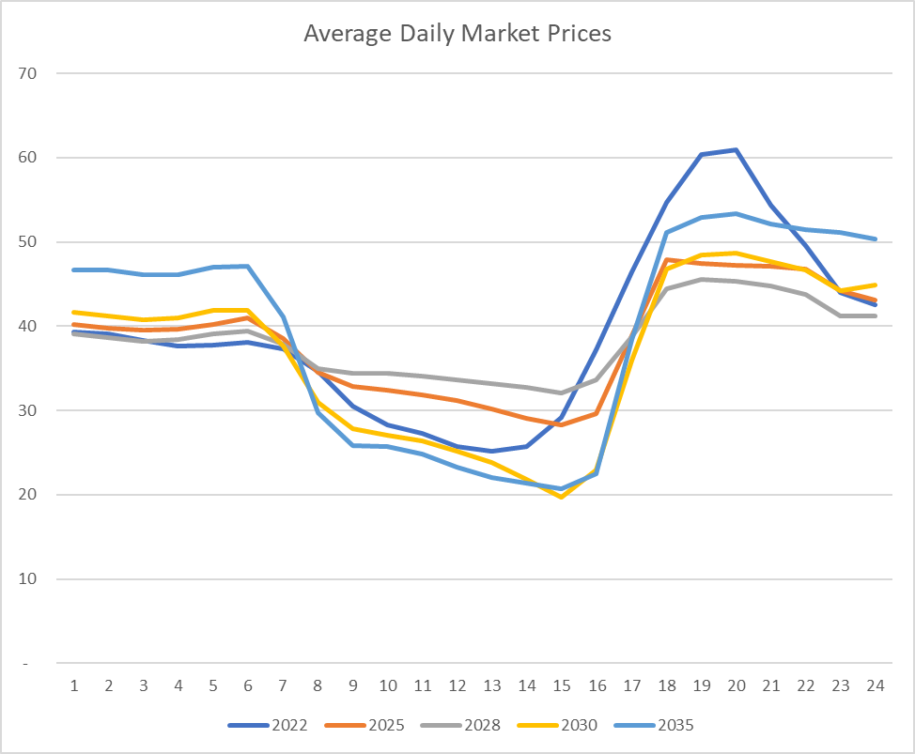
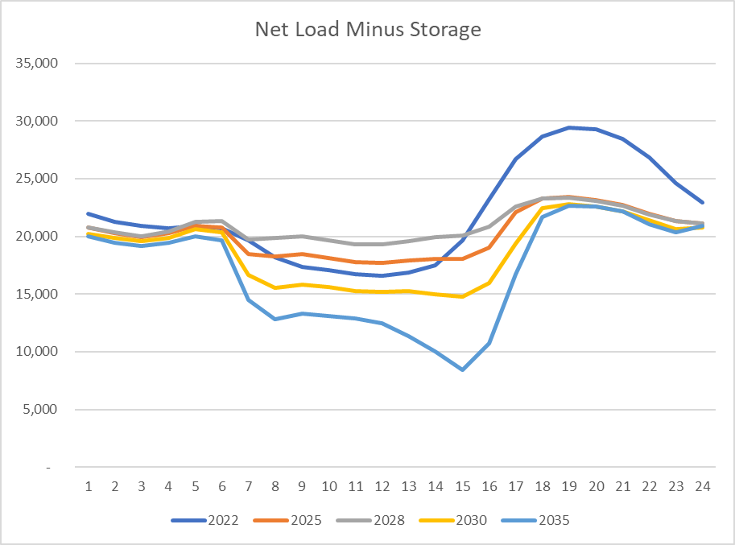
Responses to Stakeholder Comments
Market Price Trends
Driven by both storage and solar dynamics. Renewable penetration increases each year, but storage penetration increase is not uniform. Net flattening effect from 2022-2029. Steepening effect 2030+.

Slide 18
Responses to Stakeholder Comments
Negative Market Prices
Negative prices only occur when the system is curtailing renewable energy. A bid curve is used in SERVM to identify the lowest cost resource to curtail which sets the marginal energy cost.
We expect a trend of decreasing negative prices from 2023 to 2029 and continuing after that, since we expect continued deployment of storage to flatten price differences during the day. Staff will look into 2030 values and confirm in the final ACC.
Ancillary Service Pricing
SERVM uses an opportunity cost calculation to determine the ancillary service prices each hour. This function was disabled in the draft ACC leading to lower AS prices as we were continuing to evaluate results. We will fix it in the final ACC.

Slide 19
Generation Capacity Avoided Costs – E3 Presentation

Slide 20
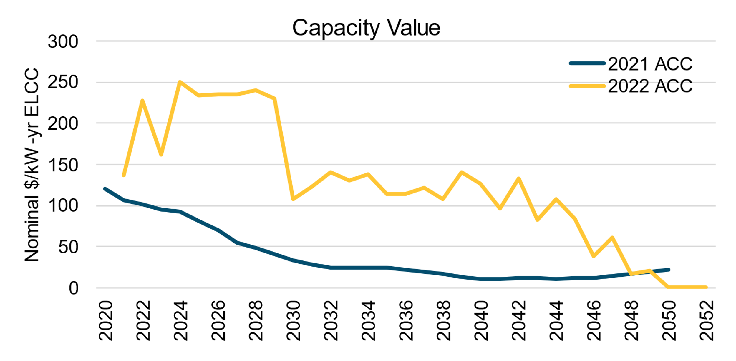
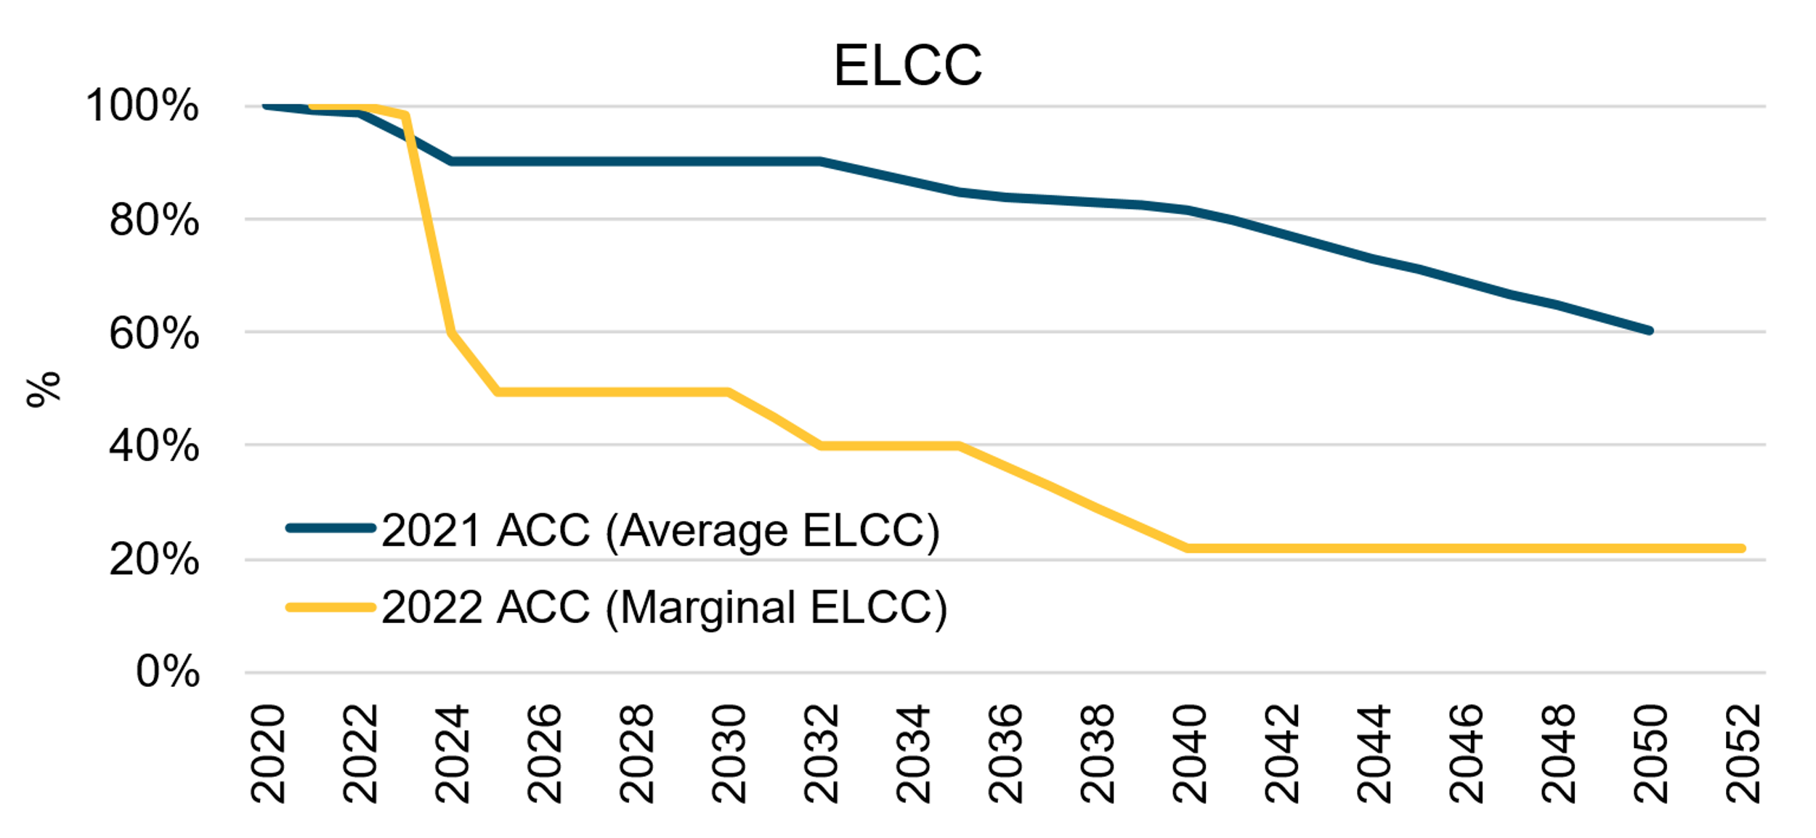
Drivers of changes in 2022 Gen Capacity Avoided Costs
Switch from weighted average Effective Load Carrying Capability (ELCC) to marginal ELCC from IRP
ACC is evaluating DERs as marginal resources
Reduced capacity contribution of storage in later years increases avoided costs
Lower near-term AS prices, less volatile long-term energy prices from SERVM
Reduced storage revenues increases avoided costs
Switching methodology from First-Year Net CONE to RECC
Increases avoided costs in early years, consistent with deferral of assets with declining costs
Slightly lower storage cost estimates from latest IRP cycle

Slide 21
RECC Methodology
Real Economic Carrying Charge (RECC) calculates the value of deferring an investment in the marginal resource (storage) by one year
Looks at the net costs (costs minus revenues) over the lifetime of the resource
Compares that to the net costs of the same resource installed the following year
Compensates resources from all vintages such that their avoided costs offset full NPV net costs
In contrast, the First-Year Net CONE approach (used in previous ACCs) considers only the first-year net costs of a resource
If the cost of a resource declines over time, the First-Year Net CONE approach undercompensates resources installed in earlier years as the price is set by cheaper resources installed in later years
 |  |  |  | Year
 |  | NPV |  | 1 | 2 | 3 | … | 25 | 26
Investment in Year 1 |  | $1,045 | ⧫ | $70 | $70 | $70 | … | $70 | $32
Investment in Year 2 |  | $958 | ⧫ | $0 | $68 | $68 | … | $68 | $68
Difference |  | $87
Illustrative Example
RECC

Slide 22
Capacity Value Calculation Walk-through part 1
Determine storage costs
Based on 4hr utility-scale storage costs from IRP
Upfront costs of new battery vintages are assumed to decline over time
Resource cost pro forma from IRP converts upfront cost into a real levelized cost, which is flat in real dollars (increases at inflation in nominal dollars)
Assumed replacement cost after lifetime also reflects assumed technology cost declines
Vintage
Levelized cost of new battery vintages decline over time
Replacement cost after lifetime is assumed to decline
Notes:
the up-front capital costs of new batteries (and O&M costs for that matter) are assumed to decline over the horizon.
the levelized cost for a new storage resource in any specific year calculated in the pro forma is a real levelized cost - meaning that this does increase (at inflation) over the assumed 20 year financial life. this real levelized cost is intended to serve as a proxy for a cost-based PPA.
the RECC, calculated as the NPV difference between LCOEs in successive vintages, starts high and decreases over the horizon - but in any given year it is higher than the first-year levelized cost of new storage in that year.

Slide 23
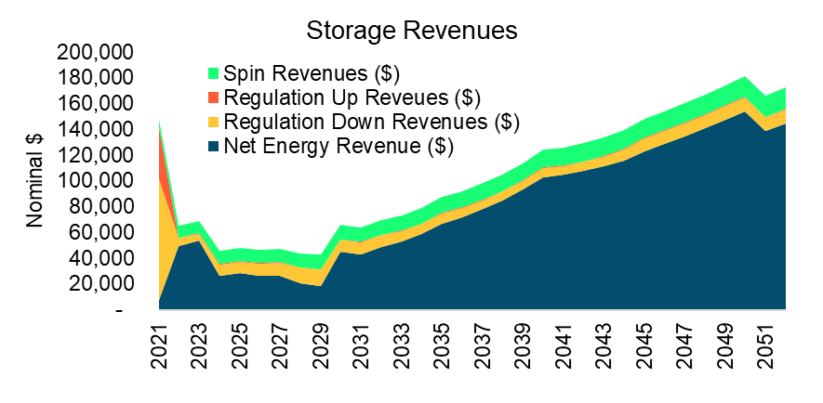
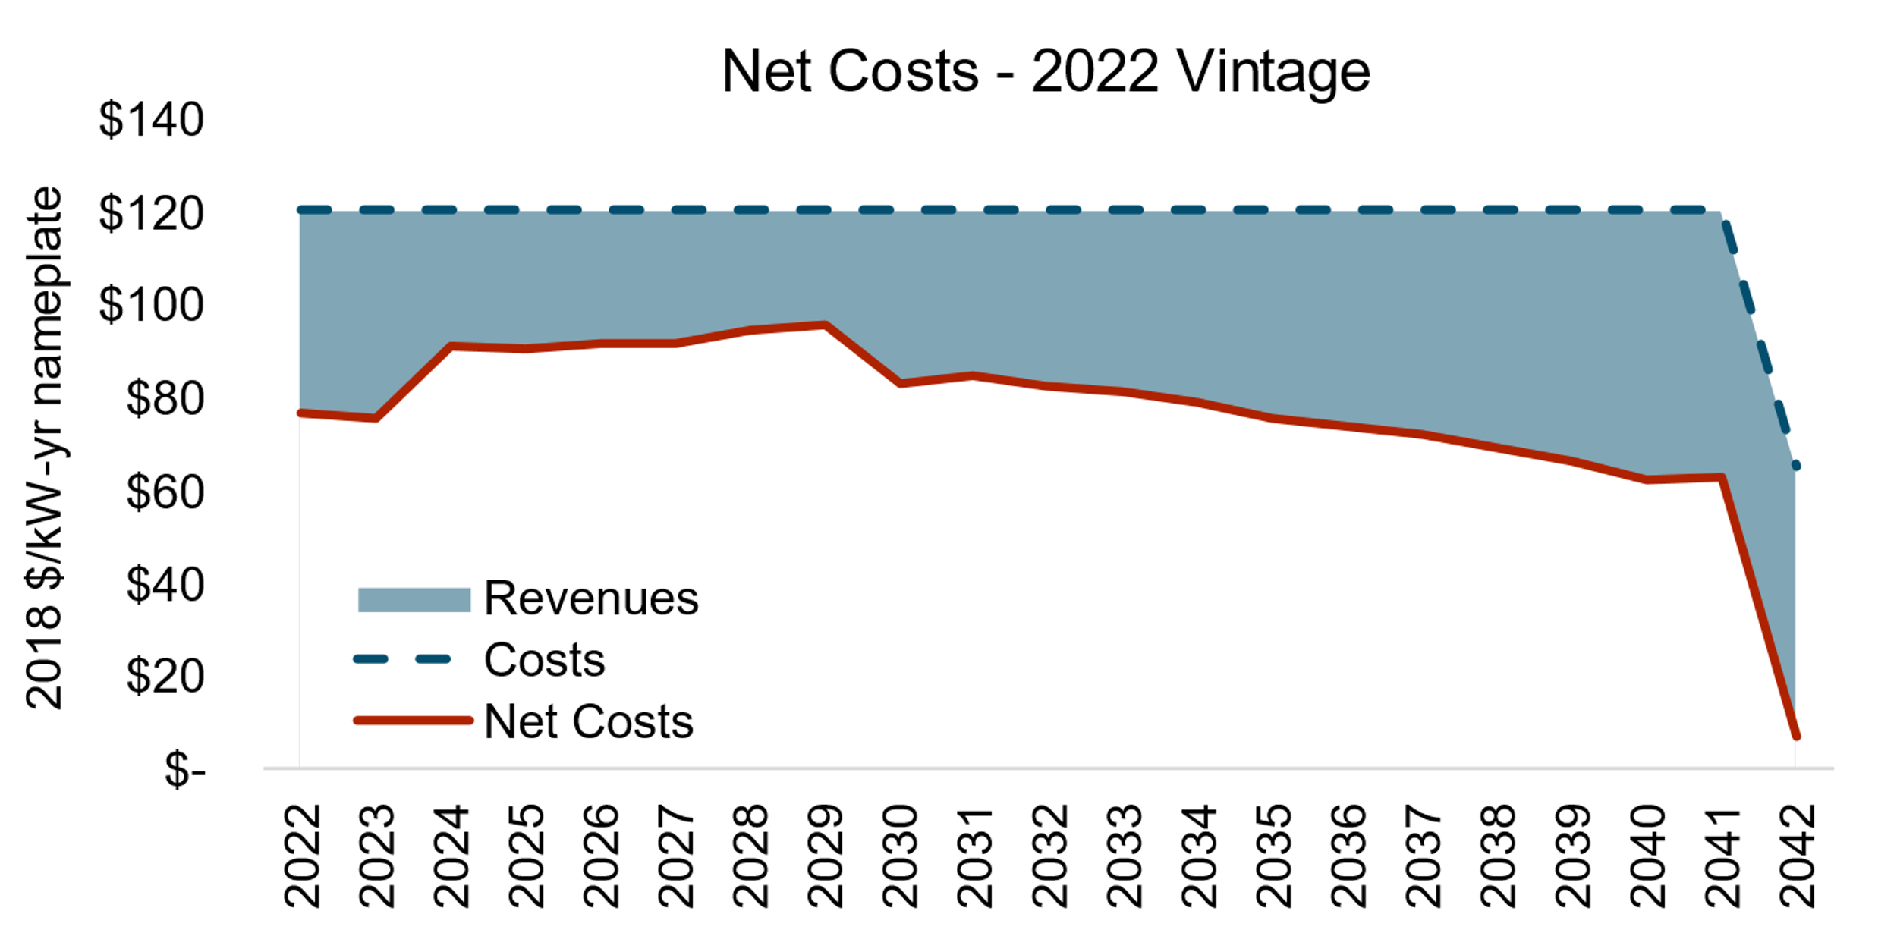
Capacity Value Calculation Walk-through part 2
Determine storage revenues
E3 RESTORE modelling of 4hr storage using SERVM prices
Varies by year.
Calculate net cost of storage
Net Costs = Storage Costs – Storage Revenues
Varies by year and by vintage of storage

Slide 24
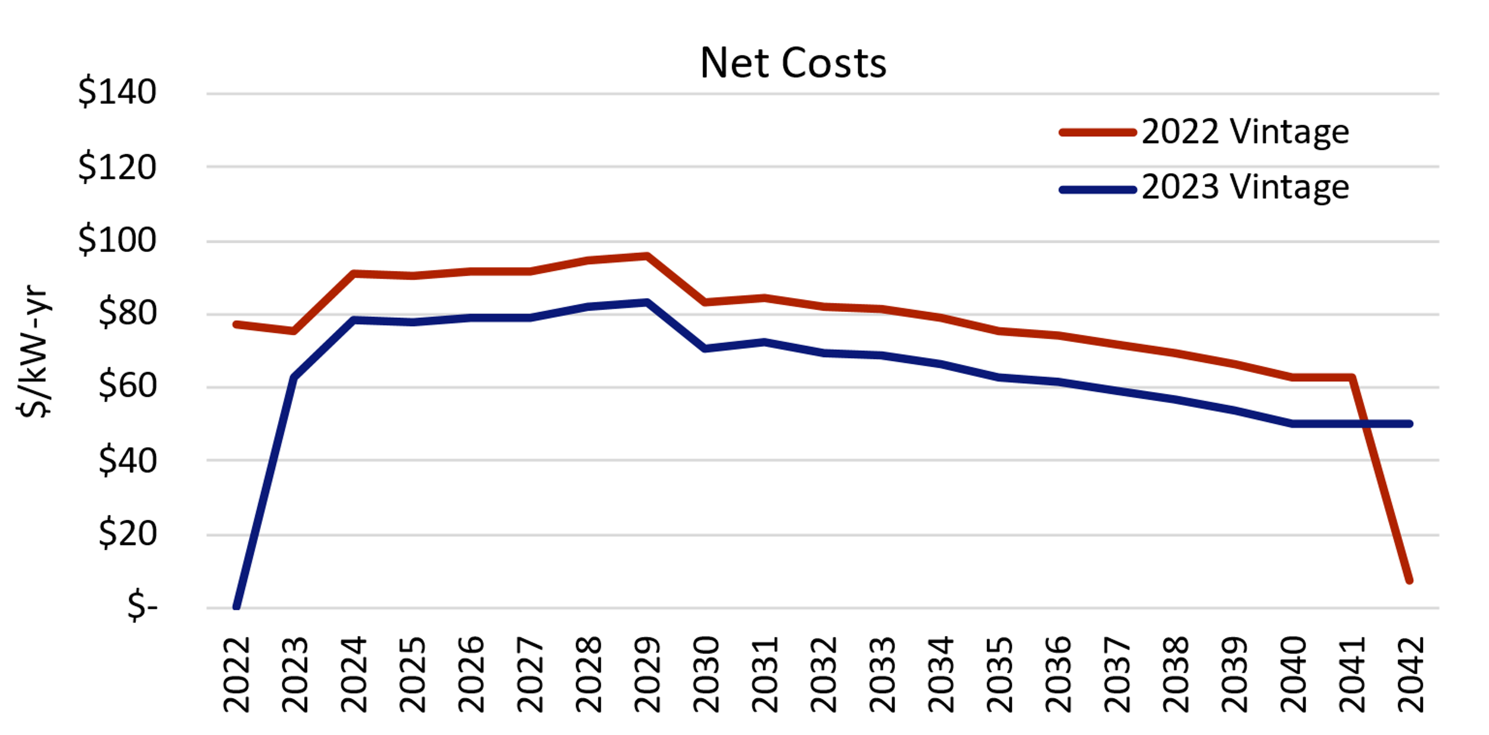
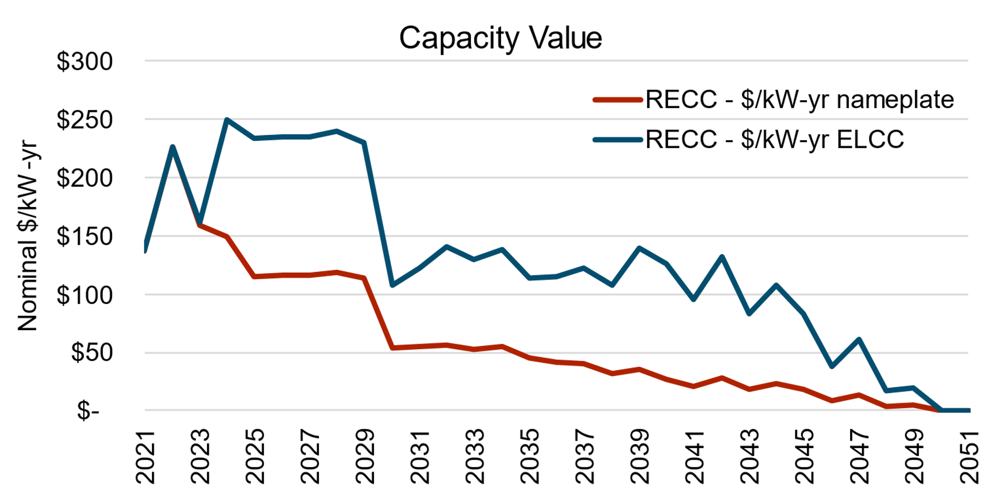
Capacity Value Calculation Walk-through part 3
Calculate the deferral value (RECC)
Adjust deferral value based on marginal ELCC of storage
RECC = NPV(Net Costs X Vintage)
− NPV(Net Costs (X + 1) Vintage)

Slide 25
Generation Capacity Avoided Costs – CLECA Presentation

Slide 38
Using SERVM for Capacity Factor Allocation

Slide 39
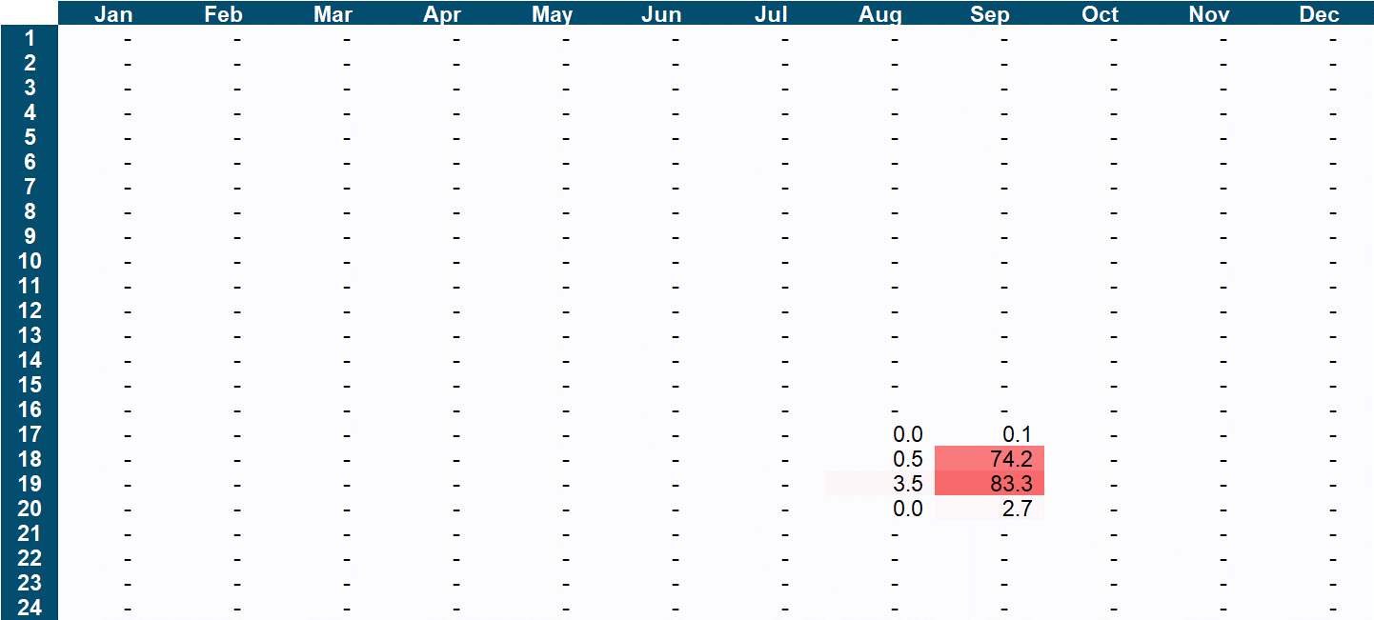
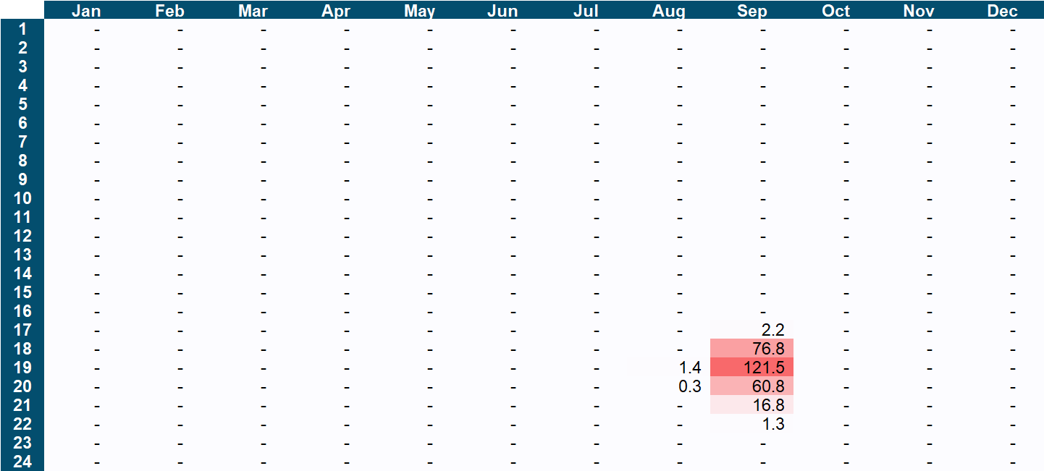
Near-term EUE Comparison
The 2022 ACC uses SERVM instead of RECAP for capacity factor allocation to be consistent with IRP
SERVM’s expected unserved energy (EUE) heatmap is used to allocate the generation capacity values to hours when the system needs the capacity
In the near term, SERVM shows EUE at 5-7 PM in September, consistent with 2021 ACC
2022 ACC using SERVM [2022]
2021 ACC using RECAP [2020]

Slide 40
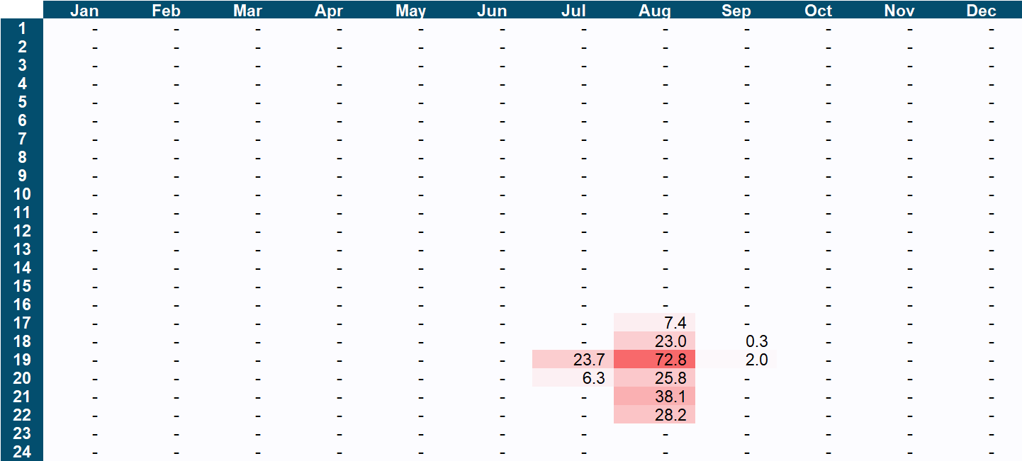
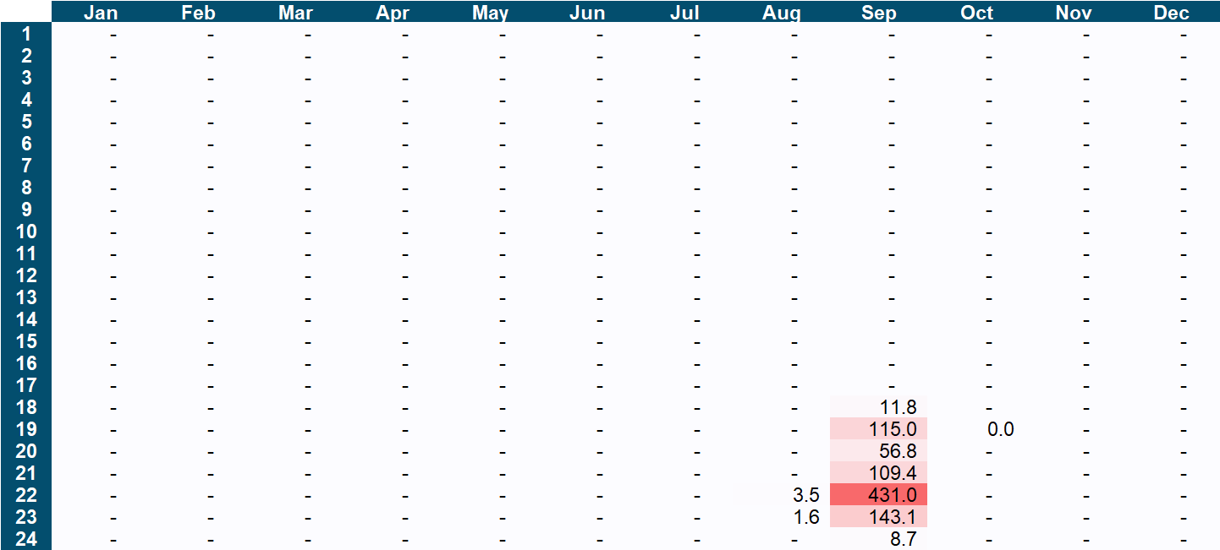
2030 EUE Comparison
SERVM’s EUE peaks at 6-7 PM in August, while RECAP’s EUE peaks at 10 PM in September
2022 ACC using SERVM [2030]
2021 ACC using RECAP [2030]

Slide 41
Transmission and Distribution

Slide 42
T&D - Continuation of Existing Methodology
Derivation of Transmission and Distribution inputs maintains consistent with the methodology used in prior ACCs, with values updated based on the most recent filings
Component | Data Source | Calculations*
Near Term Marginal Distribution Cost | Utility GNA + DDOR Filings | Use of 2019 T&D White Paper methodology to determine overloads and resulting upgrade costs in a scenario with no new DER
Long Term Marginal Distribution Cost | Utility GRC Filings | Weighted grouping of utility-filed costs by climate zone (PG&E); Sum of individual cost components presented in filing (SCE, SDG&E)
Marginal Transmission Cost | Utility GRC Filings and supplemental data requests for marginal cost factors | Utility supplied per recent CPUC ruling (PG&E); LNBA method for system-wide transmission projects (SCE); DTIM approach (SDG&E)
Hourly Allocation of Transmission Avoided Capacity Costs | CAISO Energy Management dataset | Peak Capacity Allocation Factor (PCAF) method with values realigned to match temperatures in a typical weather year
Hourly Allocation of Distribution Avoided Capacity Costs | Utility GRC Phase II (PG&E, SCE); Utility Supplied Load Data (SDG&E) | Peak Capacity Allocation Factor (PCAF)-equivalent method (calculated by utilities for PG&E, SCE) with values realigned to match temperatures in a typical weather year
*See 2022 ACC Documentation Appendix 14.3-14.5 for calculation detail

Slide 43
Near-Term Distribution Costs and Changes
Near Term Marginal Distribution
Changes in PG&E and SDG&E near term costs reflect increases in forecasted overloads
Forecasted overload values increased by 230% in PG&E’s filings compared to the 2021 ACC update. Overloads in a scenario with new DER removed would increase by 210% compared to 2021
Though SDG&E’s forecasted overloads showed little change, many circuits approached 90-100% of their maximum capacity and would exceed limits with new DER taken out – resulting in the ‘no new DER’-overloads tripling
For both utilities, decreases in per-unit upgrade costs tempered the impact on the final near-term value
2021 ACC Update (2021$) | PG&E | SCE | SDG&E
Circuits only |  | $13.12
B-Bank Substations |  | $13.18
A-Bank Substations |  | $3.29
Subtransmission |  | $0.92
Total Distribution Capacity ($/kW-yr) | $15.22 | $30.51 | $3.81
2022 ACC Update (2021$) | PG&E | SCE | SDG&E
Circuits only |  | $11.49
B-Bank Substations |  | $11.93
A-Bank Substations |  | $2.00
Subtransmission |  | $1.33
Total Distribution Capacity ($/kW-yr) | $22.70* | $26.76 | $4.35
*Draft results and documentation have not been updated for the reduction in per-unit upgrade costs and use a $45 value. This will be corrected in the final model

Slide 44
Long Term Distribution + Transmission Comparison
Long Term Marginal Distribution
Transmission Marginal Costs - Pending additional responses from SCE, SDG&E
The change in PG&E’s marginal transmission cost is based in the D.21-11-016 CPUC ruling, separate from utility or E3 calculations for the ACC
2021 ACC Update (2021$) | PG&E | SCE | SDG&E
Climate Zone | All | All | All
Long Term Distribution Capacity Cost ($/kW-yr) | $ 49.78 | $ 179.91 | $ 110.43
2022 ACC Update (2021$) | PG&E | SCE | SDG&E
Climate Zone | All | All | All
Long Term Distribution Capacity Cost ($/kW-yr) | $ 53.87 | $ 181.00 | $ 86.03
2021 ACC Update (2021$) | PG&E | SCE | SDG&E
Marginal Transmission Capacity Cost ($/kw-yr) | $12.02 | $29.18 | $14.74
2022 ACC Update (2021$) | PG&E | SCE | SDG&E
Marginal Transmission Capacity Cost ($/kw-yr) | $52.45 | - | -

Slide 45
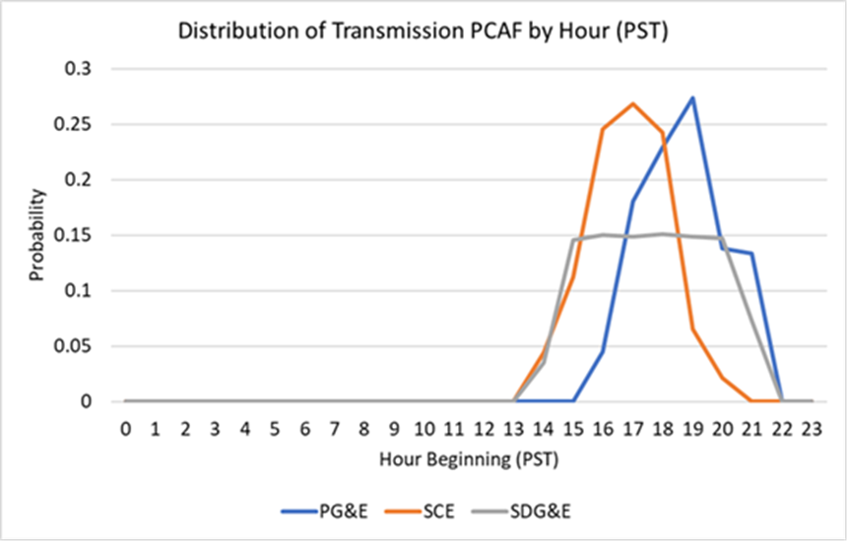
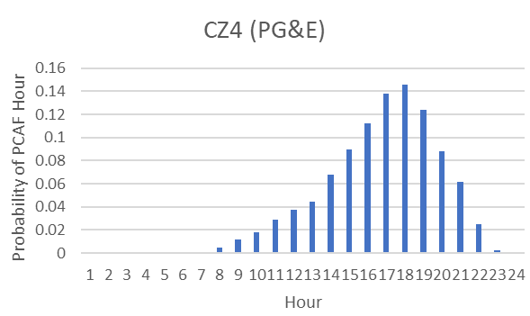
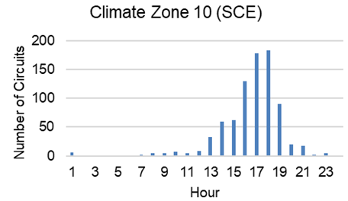
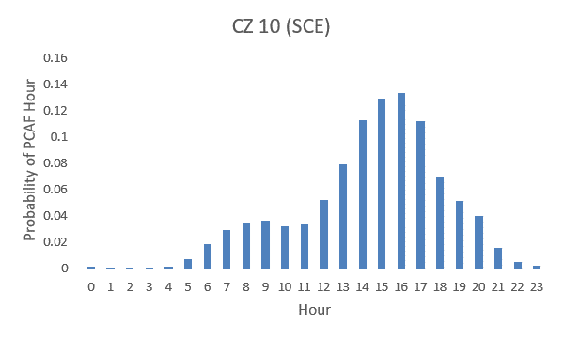
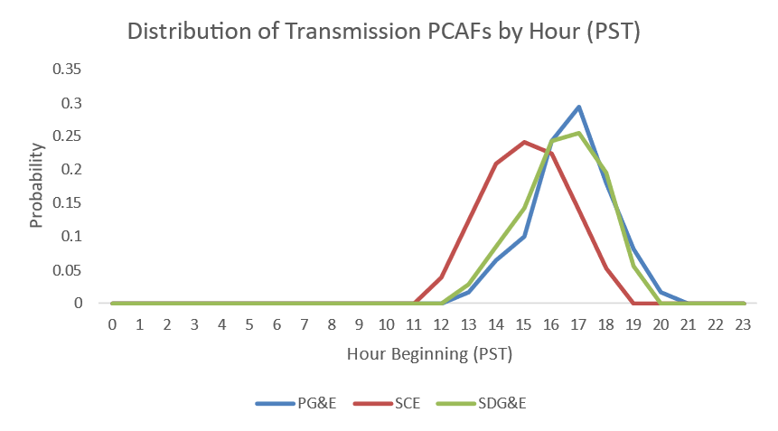
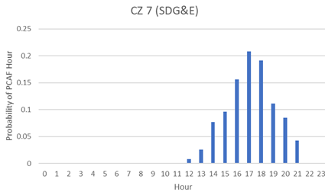
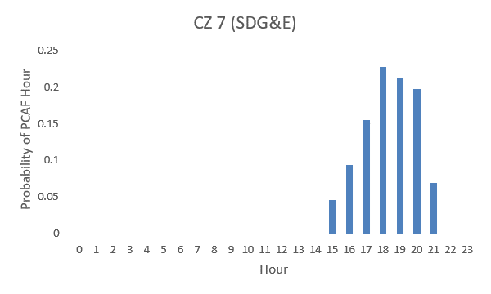
T&D Allocation Factor Updates
Transmission PCAFs
Distribution PCAFs
2021 ACC Update
2022 ACC Update
2021 ACC Update
2022 ACC Update

Slide 46
Avoided Gas Infrastructure Costs

Slide 47
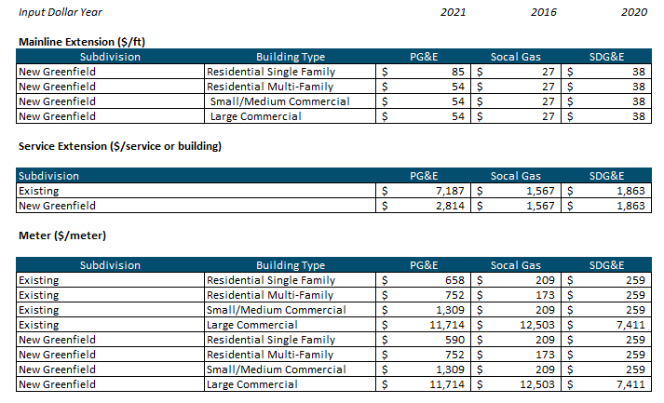
Avoided Gas Infrastructure as a new Avoided Costs in ACC
AGIC is to estimate the avoided investment in new natural gas distribution infrastructure by new construction of all-electric buildings
This avoided cost was previously adopted for Energy Efficiency programs, but will now apply to all distributed energy resource programs
This information is on a separate tab within the Gas Avoided Cost Calculator and will not be included in the hourly marginal avoided costs
It must be added separately to the benefits used in cost-effectiveness tests, and only for new construction projects, measures, and programs that have this benefit

Slide 48
IEPR Natural Gas Forecast

Slide 49
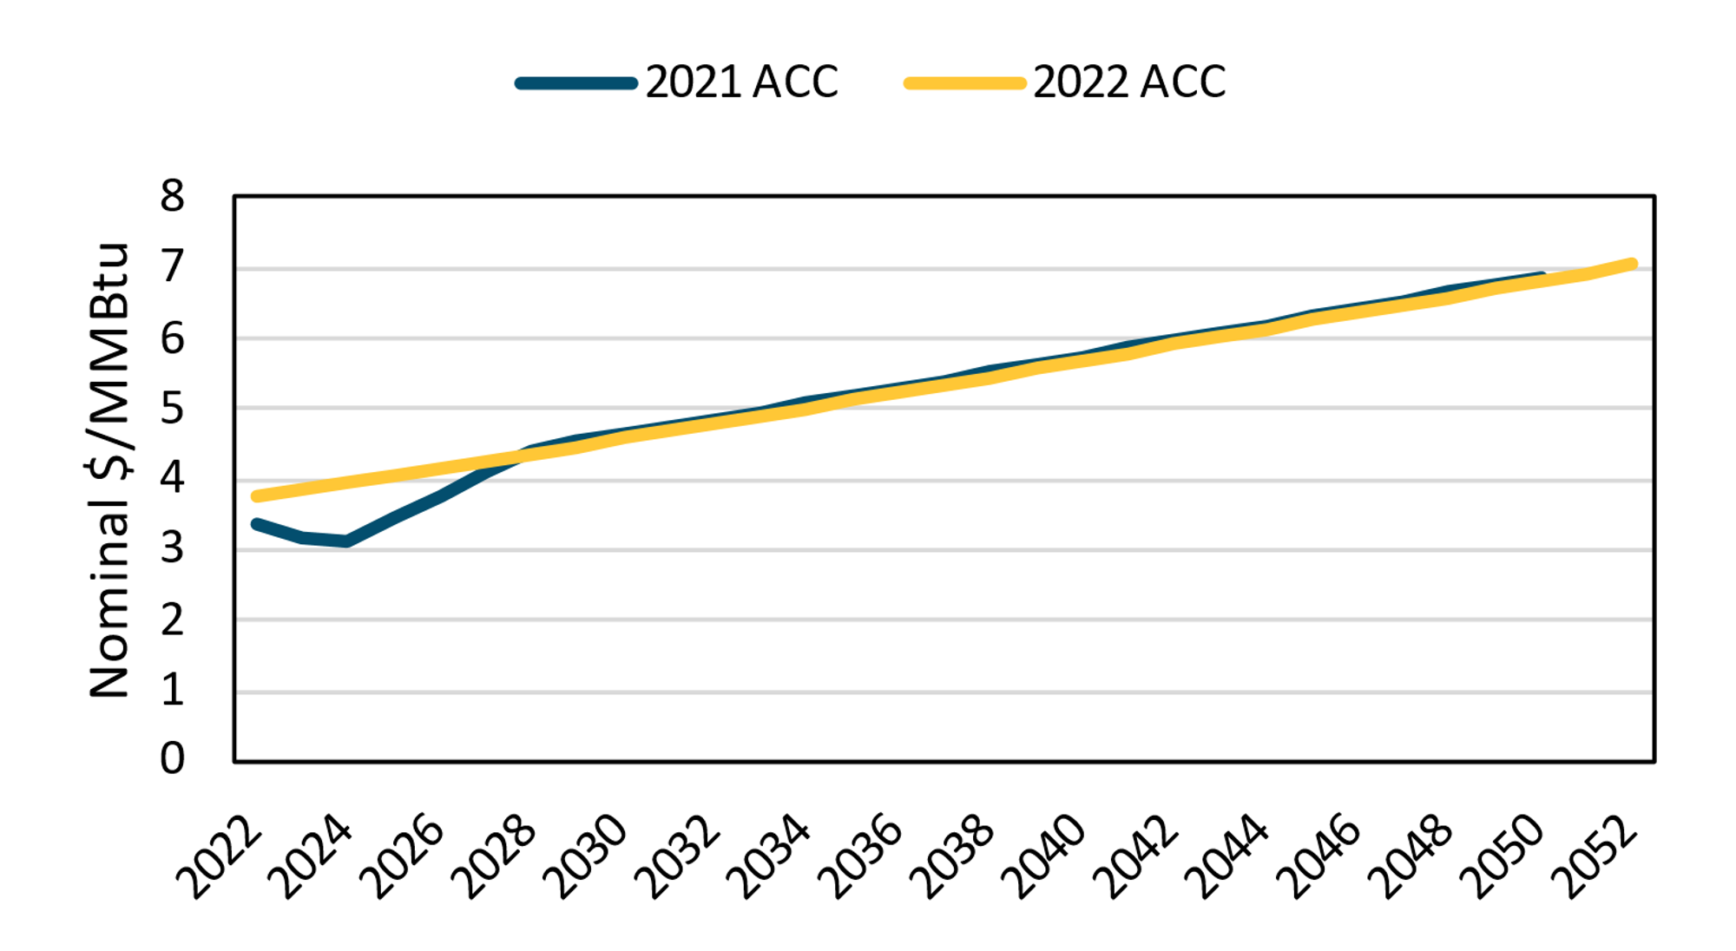
IEPR Natural Gas Forecast Used to be Consistent with IRP
In 2022 ACC, the Natural Gas ACC switched to CEC IEPR forecasts to develop near term and long term avoided costs both for retail natural gas consumption and for electric generation, to be consistent with IRP
This is to ensure that demand-side resources and supply-side resources are evaluated using the same assumptions
CA Gas Price Forecast ($Nominal)

Slide 50
Interim GHG Adder

Slide 51
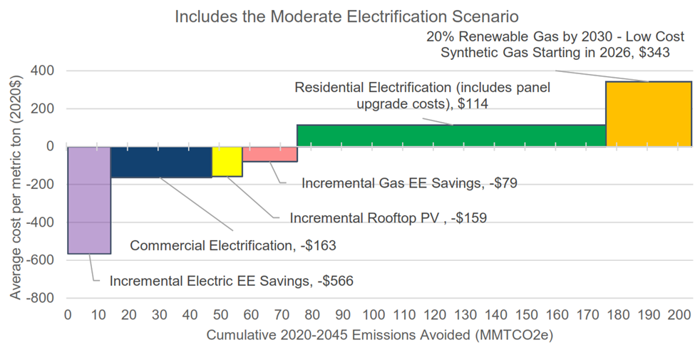
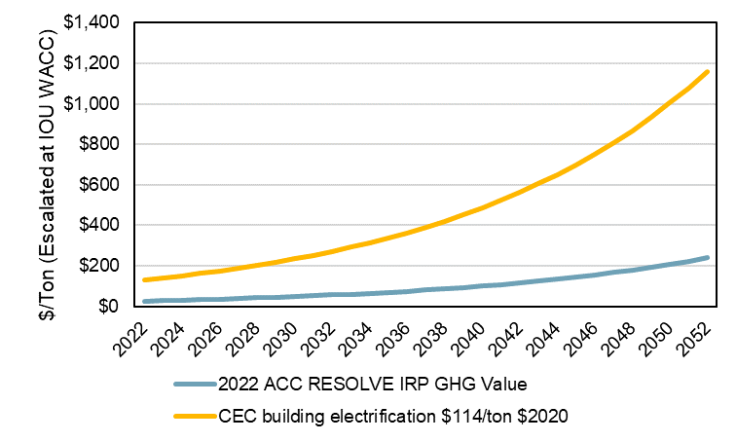
Interim GHG Adder
Natural gas avoided costs double mainly because the 2022 ACC adopts an ‘interim’ separate (and higher) GHG adder for natural gas
This is to reflect that decarbonizing direct natural gas combustion in buildings through building electrification or use of renewable natural gas is currently projected to be more expensive than avoiding GHG in electric generation
This ‘interim’ value reflects costs that will be borne by ratepayers or utilities in the future
Marginal Abatement Curve for Building Decarbonization
Natural Gas GHG vs Electric GHG Avoided Costs
(CEC California Building Decarbonization Assessment, 2021) Figure 15, p. 56
Note: the costs are in $/tonne. Will clarify in the final calculator
Note: After thinking through a stakeholder’s feedback, we agree that the refrigerant calculator should adopt the GHG value consistent with the gas model, instead of the electric model. We will update this in the final calculator.

Slide 52
Refrigerant Calculator

Slide 53
Refrigerant Calculator 2022 Updates
There are three main updates to the 2022 Refrigerant Calculator in the ACC:
Refrigerant leakage is discounted at the mid-year instead of at the end of each year to be more consistent with continuous leakage throughout the device lifetime
There is an option for a user-specified refrigerant GWPs for refrigerants that are not listed in the provided database
The avoided cost calculation is performed for a measure instead of for a single device.

Slide 54
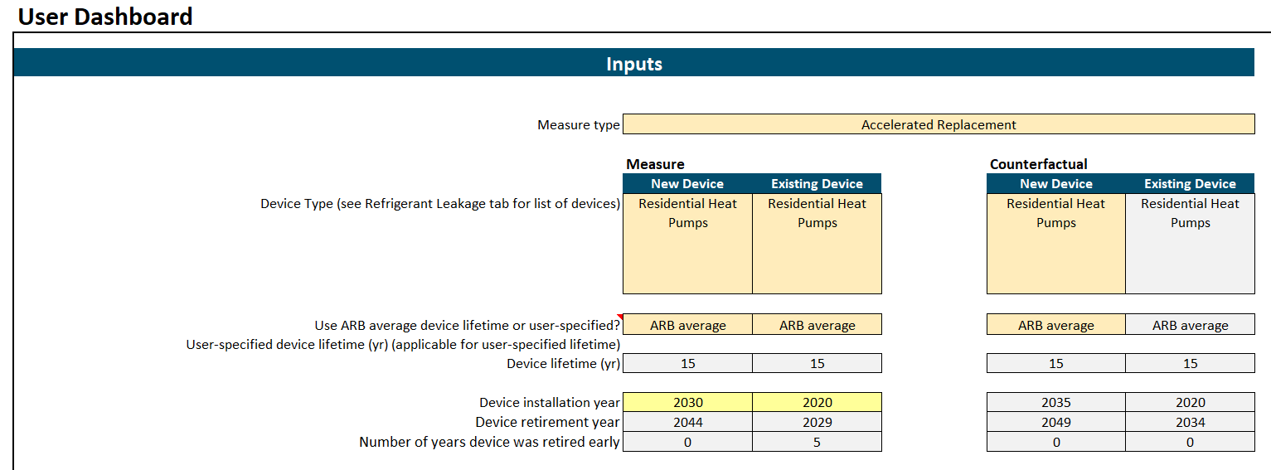
Refrigerant Leakage Avoided Cost by Measure Type
2022 Refrigerant Calculator calculates the avoided cost due to changes in refrigerant leakage for a measure compared to a counterfactual
Measure types include Normal Replacement, Add-on Equipment, and Accelerated Replacement
This update requires the user to specify the input parameters both the measure and counterfactual

Slide 55
SEIA Presentation

Slide 56
Workshop on the Draft 2022 Avoided Cost Calculator
Tom Beach
Principal Consultant
Crossborder Energy
Consultant to Solar Energy Industries Association
June 30, 2022
Crossborder Energy * 2560 Ninth Street * Suite 213A * Berkeley CA 94710 * tomb@crossborderenergy.com

Slide 57
Caveats to this presentation
Issues may overlap with other topics presented today.
Issues are still under review.
SEIA reserves the right to address other issues not listed here.

Slide 58
Avoided T&D costs
What is the process for review of updated SCE and SDG&E avoided transmission costs not yet provided to Energy Division?
Escalation in avoided transmission costs
2.06% to 2.34% per year inflation rates are too low
Recent historical increases in transmission costs are much higher
IOU Transmission Revenue Requirement: - +7%/year (2016-2021)
CAISO TAC charge: +11% per year (2009-2020)
Residential transmission rates: +11% per year (2009-2022)
Future: $30.5 billion in new transmission by 2040
Per the CAISO’s 20-year Transmission Plan
Deferrable by distributed energy resources that reduce load or produce renewable energy
The CAISO long-term plan is consistent with avoided transmission costs increasing at 8% per year.

Slide 59
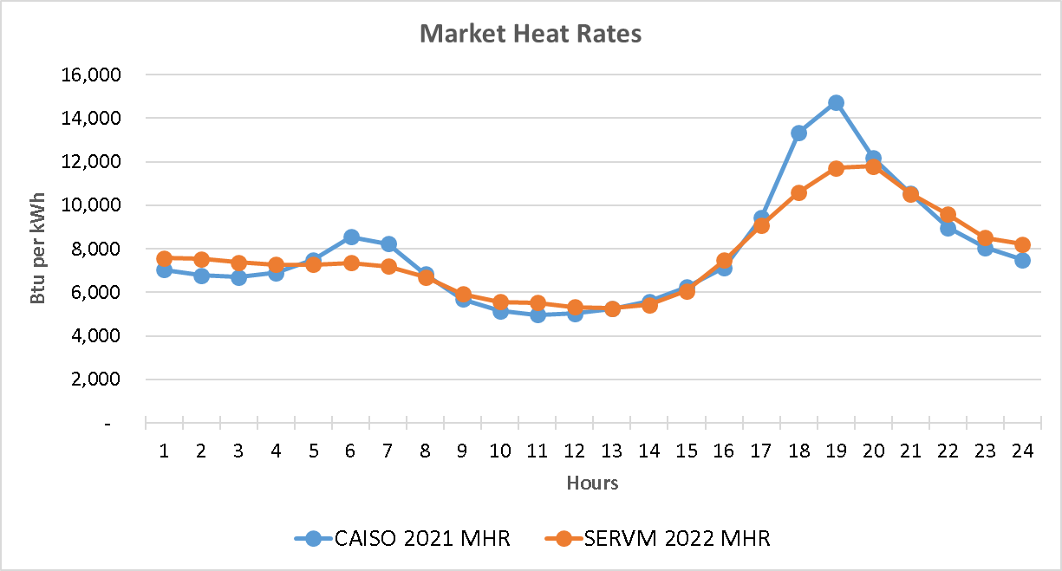
Concerns with SERVM results
Algorithmic changes to SERVM
2020 to 2021 to 2022 – what was the impact of the errors corrected?
Quantify the benchmarking results
Scarcity adjustment is limited to too-few hours

Slide 60
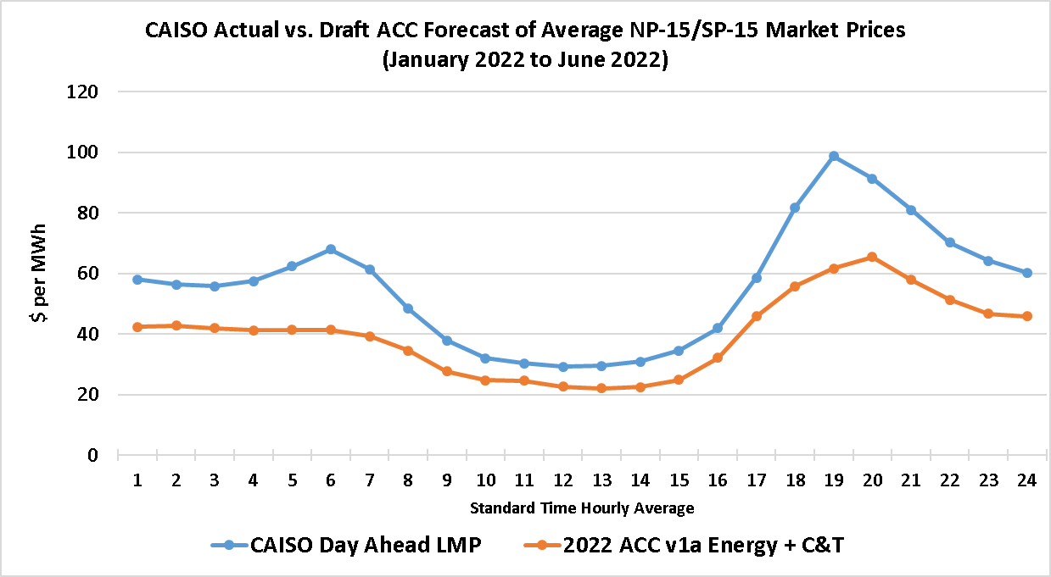
The 2022 ACC Will Not Be Accurate [1]
First needed modification to D. 22-05-002
A realistic, up-to-date natural gas forecast

Slide 61
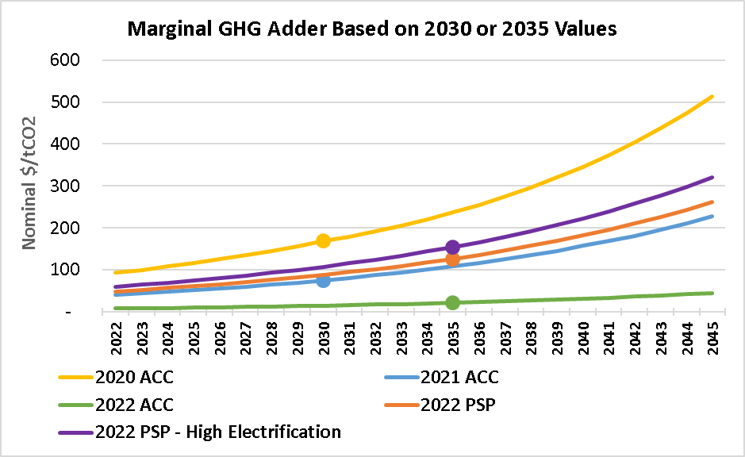
The 2022 ACC Will Not Be Accurate [2]
Second needed modification to D. 22-05-002
ACC must reflect the state’s electrification goals

